Slide 1
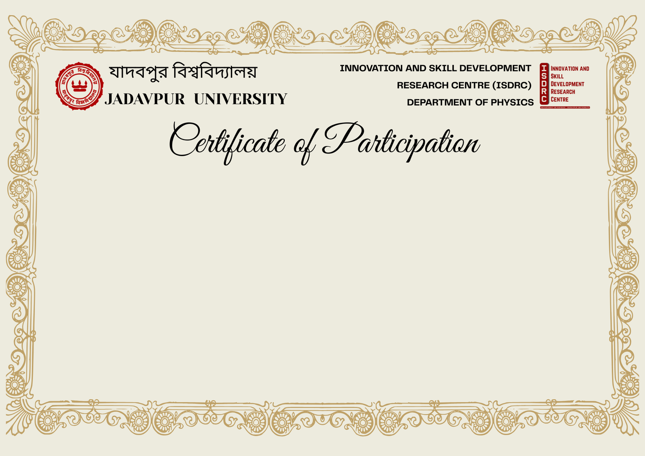

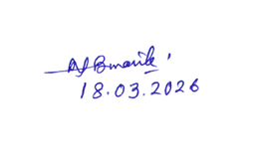


This is to certify that
Rangan Chakrabarty
from Jadavpur University
has successfully presented a poster, entitled “Superdense Coding Protocol in Maximally and Non-Maximally Entangled Bell State: an Experimental Realisation”, at the One-Day National Seminar on Scientific Innovation and Skill Development for Societal Advancement, organised by the ISDRC, Department of Physics, Jadavpur University, Kolkata –700032, India, held on 18 March 2026.
The Organising Committee gratefully acknowledges his/her participation and contribution to this seminar.
Prof. Nabin Baran Manik
Coordinator, ISDRC
Department of Physics
Jadavpur University
Prof. Brajadulal Chattopadhyay
HOD
Department of Physics
Jadavpur University
Prof. Shamik Ghosh
Dean of Science
Department of Mathematics
Jadavpur University

